Slide 1
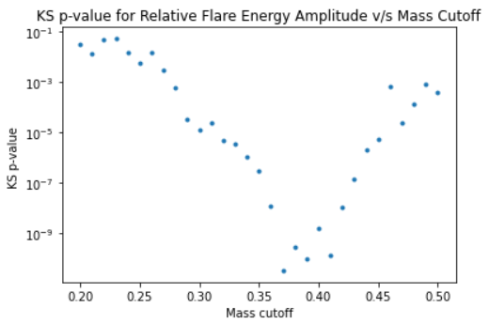
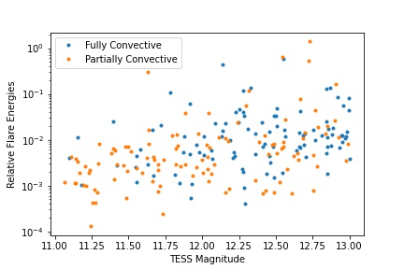
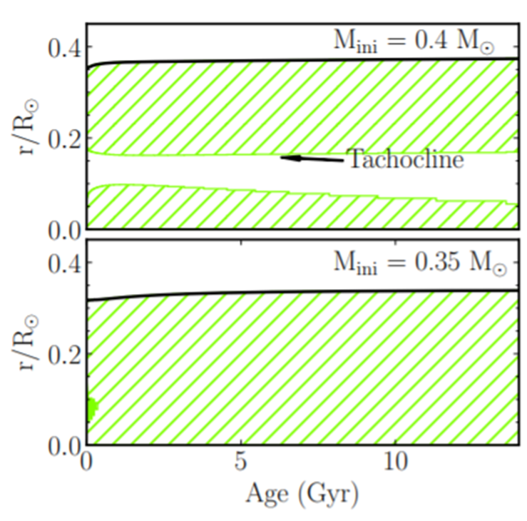
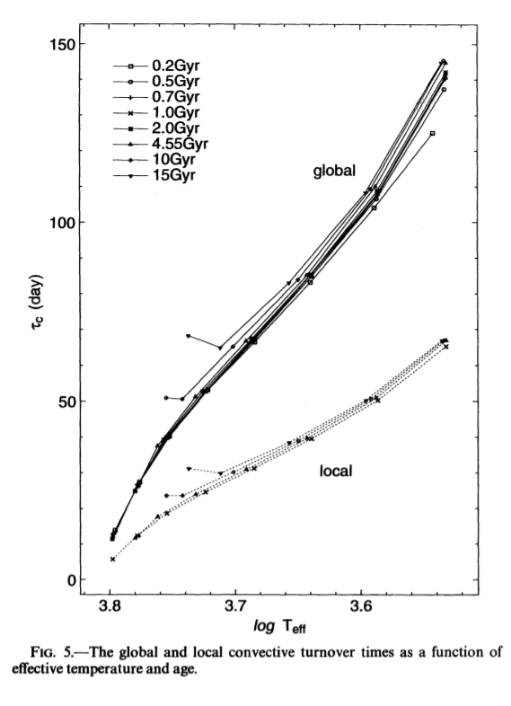
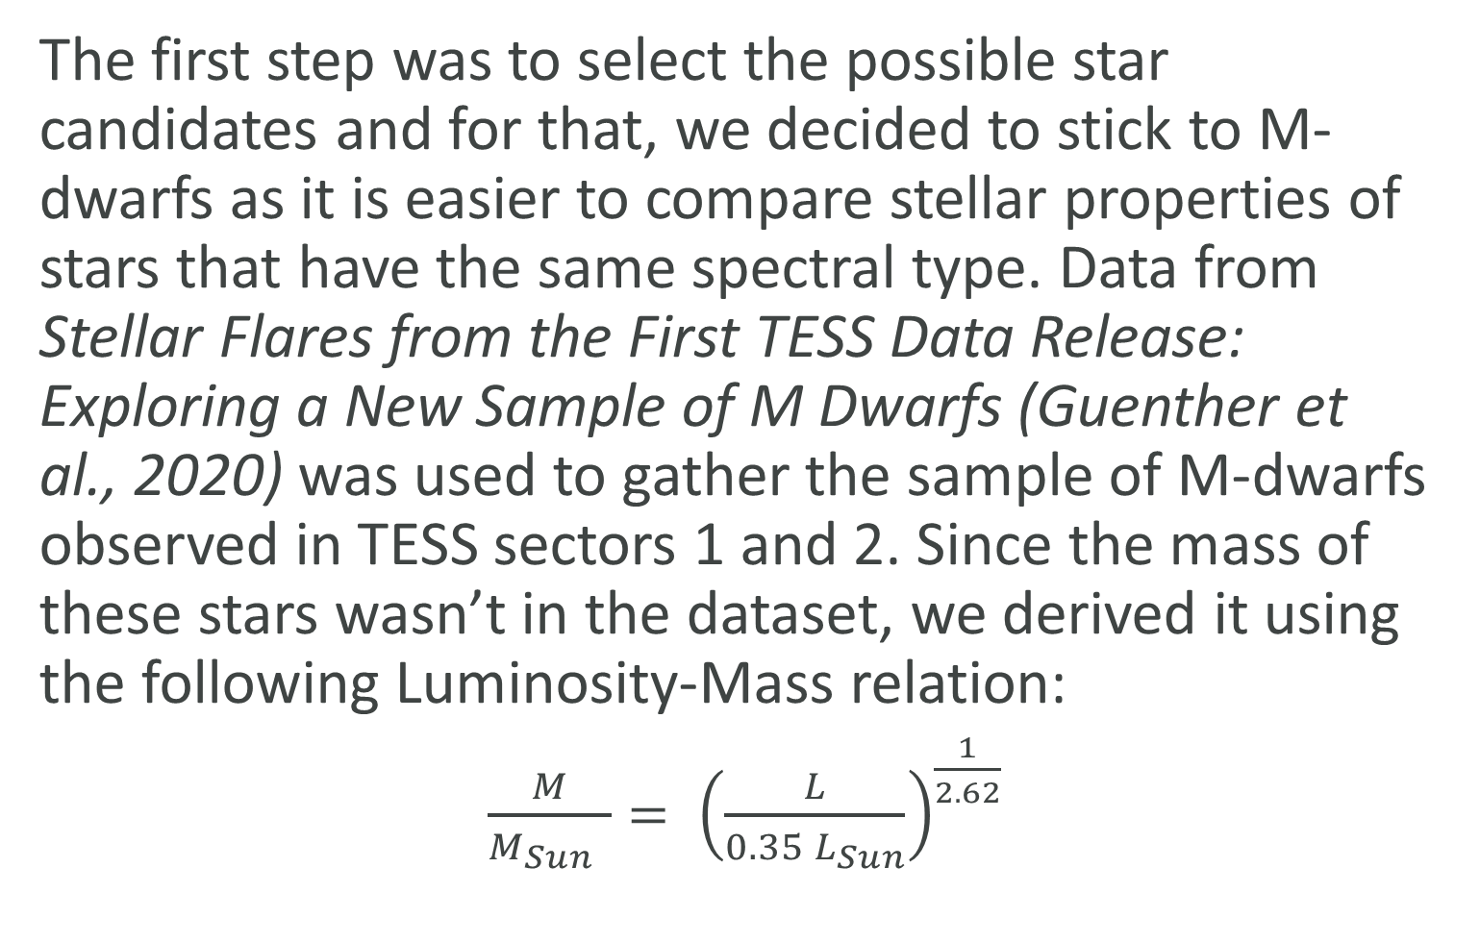
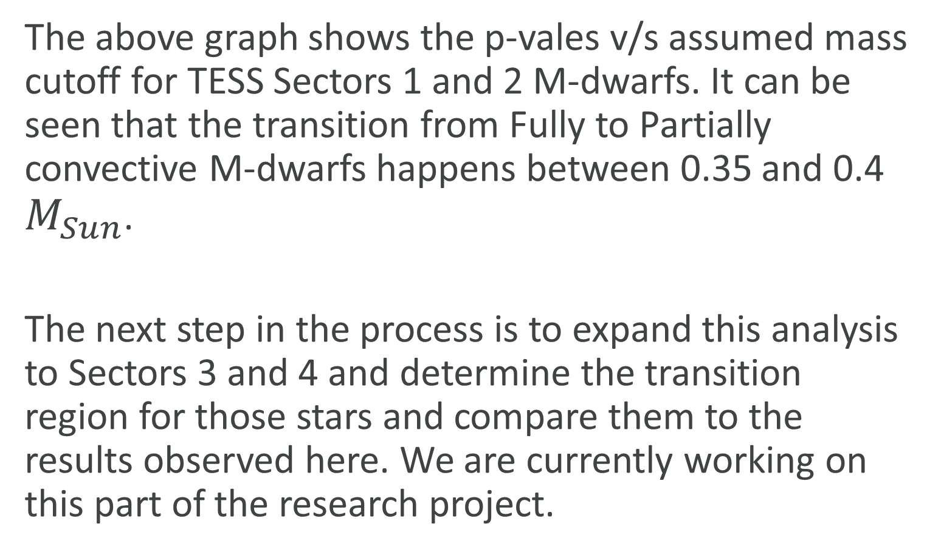
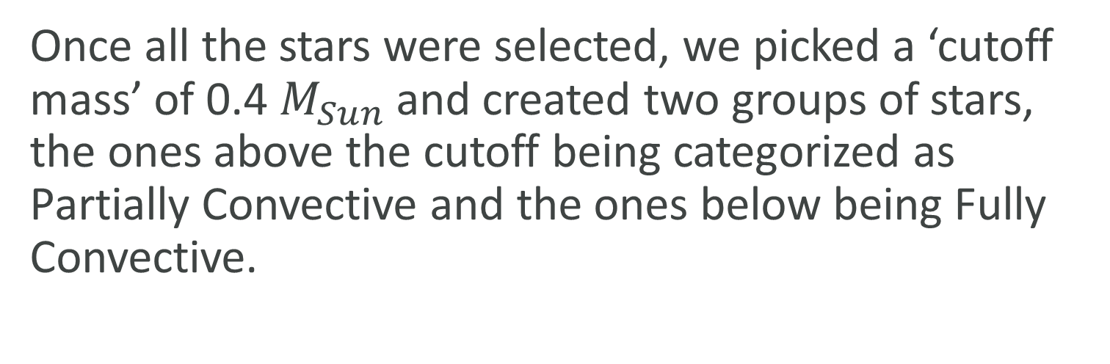
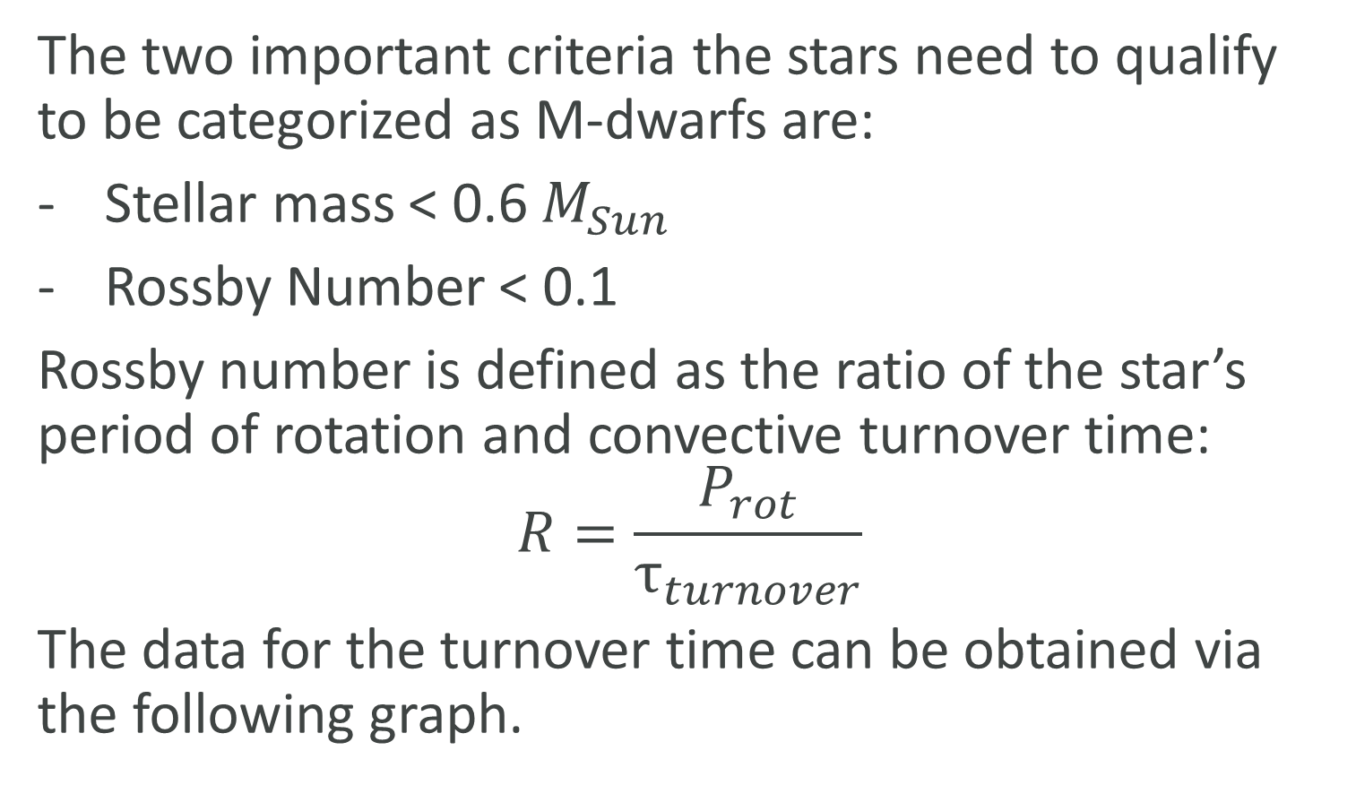
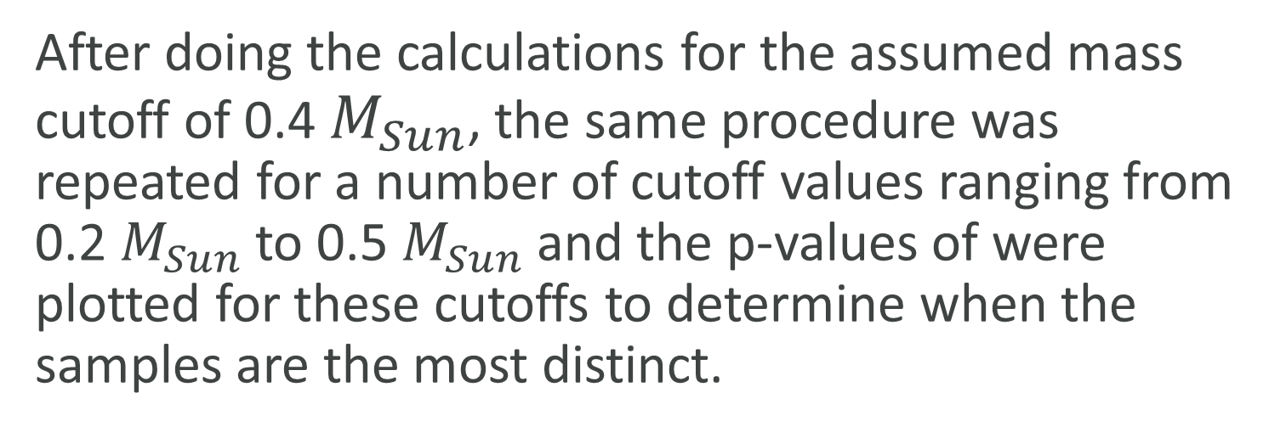
Department of Astronomy
Identifying Fully Convective M-dwarfs in TESS Sectors 1 and 2
Avidaan Srivastava; Advisor: Dr. Ji Wang
INTRODUCTION
The two important criteria the stars need to qualify to be categorized as M-dwarfs are:
Stellar mass < 0.6 $M_{Sun}$
Rossby Number < 0.1
Rossby number is defined as the ratio of the star’s period of rotation and convective turnover time:
$$R=\frac{P_{rot}}{τ_{turnover}}$$
The data for the turnover time can be obtained via the following graph.
We then used the TESS Input Catalog identifier (TIC) to extract the lightcurves of all these stars from Lightkurve and removed any possible flares and other selection biases from the data.
RESULTS
In Low Mass Stars, the surface magnetic fields are produced due to a dynamo action in the convective region where a part of the kinetic energy is converted into magnetic energy. The boundary between the convective and radiative region of the star, known as the Tachocline, plays a role in creating stellar magnetism in these low mass stars. Since the Tachocline doesn’t exist in Fully Convective stars, separating them from Partially Convective stars will make it easier to understand the effect of the Tachocline.
The above graph shows the p-vales v/s assumed mass cutoff for TESS Sectors 1 and 2 M-dwarfs. It can be seen that the transition from Fully to Partially convective M-dwarfs happens between 0.35 and 0.4 $M_{Sun}$.
The next step in the process is to expand this analysis to Sectors 3 and 4 and determine the transition region for those stars and compare them to the results observed here. We are currently working on this part of the research project.
Once the final sample was obtained, we plotted a Cumulative Distribution Function (CDF) for Relative Flare Energy and Spot Filling Factor and compared the two CDFs using the Kolmogorov-Smirnov (KS) test. The ‘p-value’ result from the test tells us how different the two samples are such that the lower the p-value, the more different they are.
(Bochanski, Cantiello, Wang)
Relative Flare Energy
Relative Flare Energy α (Flare Amplitude )²
Higher Flare Amplitude means Higher Magnetic Flux
BIBLIOGRAPHY
METHODS
Bochanski, Cantiello, Wang, 2019
Kim and Demarque, 1996
Selecting the Stars
Spot Filling Factor
The first step was to select the possible star candidates and for that, we decided to stick to M-dwarfs as it is easier to compare stellar properties of stars that have the same spectral type. Data from Stellar Flares from the First TESS Data Release: Exploring a New Sample of M Dwarfs (Guenther et al., 2020) was used to gather the sample of M-dwarfs observed in TESS sectors 1 and 2. Since the mass of these stars wasn’t in the dataset, we derived it using the following Luminosity-Mass relation:
$\frac{M}{M_{Sun} }= {\left(\frac{L}{0.35 L_{Sun}}\right)}^{\frac{1}{2.62}}$
Percentage of star surface covered with spots
Fractional variation in lightcurve data is directly related to the spot filling factor
ACKNOWLEDGEMENTS
This project was only possible thanks to my advisor, Dr. Ji Wang, and The Oho State University Department of Astronomy for accepting me into the Summer Undergraduate Research Program in the Summer of 2021.
(Kim and Demarque, 1996)
Analysis (cont.)
Analysis
After doing the calculations for the assumed mass cutoff of 0.4 $M_{Sun}$, the same procedure was repeated for a number of cutoff values ranging from 0.2 $M_{Sun}$ to 0.5 $M_{Sun}$ and the p-values of were plotted for these cutoffs to determine when the samples are the most distinct.
Once all the stars were selected, we picked a ‘cutoff mass’ of 0.4 $M_{Sun}$ and created two groups of stars, the ones above the cutoff being categorized as Partially Convective and the ones below being Fully Convective.

